Slide 1
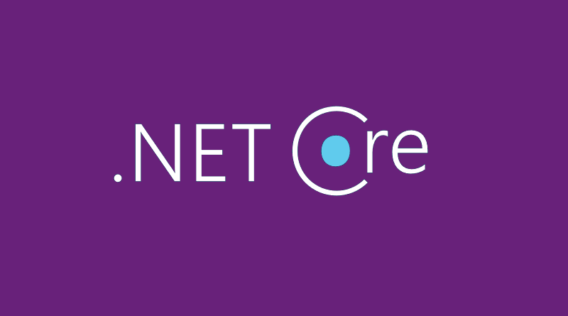

.NET CORE
INTRODUCTION
Notes:
Hello, everyone! Welcome to Aitrich Academy .Today, we're embarking on an exciting journey into the world of .NET Core, a versatile framework that's going to empower you in your coding adventures. A robust framework for building modern, scalable, and cross-platform web applications.ASP.NET Core is an evolution of the ASP.NET framework, designed to meet the challenges of modern web development and provide a flexible, high-performance platform.

Slide 2

Contents
Introduction
Advantages
Features
Technologies Included in the ASP .NET Framework
Environment setup
Notes:
Today, we have an exciting agenda as we dive into the world of ASP.NET Core. We'll begin with an introduction and highlight the advantages this powerful framework brings to the table.
Moving on, we'll explore the features that make ASP.NET Core a go-to choice for modern application development. We'll delve into the technologies that are seamlessly integrated into ASP.NET Core, providing a robust development environment.
Finally, we'll discuss the crucial step of setting up the environment for ASP.NET Core development. So, buckle up, and let's embark on this journey of discovery and learning about ASP.NET Core!

Slide 3

Introduction
.NET : Free. Cross platform. Open source.
A developer platform for building all your apps: web, mobile, desktop, gaming, IoT, and more. Supported on Windows, Linux, and macOS.
Developed by Microsoft
.NET Core is a successor to .NET Framework and was introduced in 2014 as a cross-platform
Notes:
Introduction
.NET is not just free, it's also cross-platform and open source. That means you can develop your applications on various operating systems like Windows, Linux, and macOS without any constraints.
- Think of it as your one-stop-shop for building applications—whether they're web, mobile, desktop, gaming, IoT, or anything else you can dream up. .NET has got you covered.
- Who's behind this magic? Microsoft, the brains behind .NET, has been steering the ship since day one. But here's where it gets interesting: .NET Core isn't just an update; it's a successor to the well-known .NET Framework. It made its debut in 2014, introducing a cross-platform approach to application development.
And here's a noteworthy update: the latest version of .NET Core is 8, demonstrating the continuous evolution and enhancement of this powerful developer platform. So, let's buckle up and explore the limitless possibilities that the latest .NET Core version brings to your development journey!

Slide 4
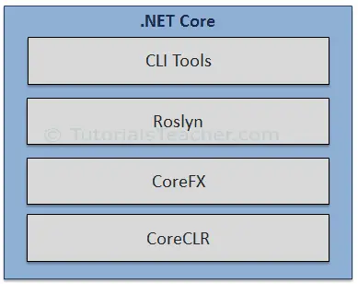
.NET Core Composition
CLI Tools: A set of tooling for development and deployment.
Roslyn: Language compiler for C# and Visual Basic
CoreFX: Set of framework libraries.
CoreCLR: A JIT based CLR (Command Language Runtime).
Notes:
DotNet Core Composition
let's dive into the composition of .NET Core and understand the core elements that make it a powerful framework for development.
First up, we have the CLI Tools, a set of essential tooling for both development and deployment. These command-line tools provide efficiency and flexibility throughout the development lifecycle.
Moving on, we encounter Roslyn, a crucial component. It's not just a name; it's the language compiler for both C# and Visual Basic. Roslyn plays a pivotal role in turning your code into executable applications.
Now, let's talk about CoreFX. It's a set of framework libraries that form the building blocks of your applications. These libraries provide the functionality you need to create robust and feature-rich software.
Last but certainly not least, we have CoreCLR. This is where the magic happens! CoreCLR is a Just-In-Time (JIT) based Common Language Runtime. It executes your code and manages resources efficiently, making sure your applications run smoothly.
So, in a nutshell, the combination of CLI Tools, Roslyn, CoreFX, and CoreCLR forms the robust composition of .NET Core. It's a well-coordinated symphony of elements that empowers developers to create, compile, and run applications seamlessly. Get ready to harness the power of .NET Core composition!

Slide 5

Advantages
Cross-platform support.
Use of microservices.
Use of Docker containers.
High performance and scalability requirements.
Side-by-side versioning of .NET versions by application on the same server.
modular, lightweight, fast
Flexible Deployment
Notes:
Alright, let's delve into the advantages of .NET Core. These aspects truly set it apart in the world of application development.
First and foremost, we have cross-platform support. That means you can develop and run .NET Core applications on Windows, Linux, and macOS. No more platform constraints – it's the freedom to choose.
Next up, the use of microservices. .NET Core seamlessly integrates with the microservices architecture, allowing you to build scalable and maintainable systems. It's all about breaking down complexity into manageable pieces.
Now, Docker containers. .NET Core embraces containerization with Docker, offering a portable and consistent environment. This not only simplifies deployment but also ensures that your application runs reliably across different environments.
High performance and scalability are non-negotiable in today's tech landscape. .NET Core is designed with these requirements in mind, providing a runtime that's not only fast but also scales with your application's demands.
One of the cool features is side-by-side versioning. You can run different versions of .NET on the same server for different applications. It's like having multiple tools in your toolbox without any conflicts.
Let's talk about deployment. .NET Core gives you flexible deployment options. Deploy your application the way that suits you best, whether it's on-premises, in the cloud, or in a hybrid environment.
In a nutshell, .NET Core is modular, lightweight, and fast. It adapts to your needs, making development and deployment a breeze. Get ready for a smoother, more flexible, and highly efficient development experience with .NET Core!

Slide 6
Features
Asynchronous code
Attributes
Reflection
Code analyzers
Delegates and lambdas
Events
Exceptions
Garbage collection
Generic types
LINQ (Language Integrated Query).
Parallel programming
Type system
Notes:
- Let's explore the rich set of features that make .NET Core a developer's playground.
- Asynchronous Code:First off, we have support for asynchronous code. This allows us to write non-blocking code, enhancing the performance of our applications.
- Attributes:Attributes enable us to add metadata and behaviors to our code, providing a way to add additional information that impacts how the code behaves.
- Reflection:Reflection allows us to inspect and interact with types and objects at runtime, providing a powerful tool for dynamic behaviors.
- Code Analyzers:These tools help us maintain code quality by identifying potential issues, suggesting improvements, and enforcing coding standards.
- Delegates and Lambdas:.NET Core supports delegates and lambdas, offering powerful ways to work with functions and handle events.
- Events:Events provide a way for objects to communicate and respond to actions or state changes, enhancing the flexibility of our applications.
- Exceptions: Exception handling ensures our applications gracefully handle errors and unexpected situations, improving overall robustness.
- Garbage Collection:Automatic memory management through garbage collection helps us focus on coding without worrying too much about memory allocation and deallocation.
- Generic Types: Generics allow us to write code that works with different types, promoting code reusability and type safety.
- LINQ (Language Integrated Query): LINQ simplifies data manipulation and querying by integrating query capabilities directly into the C# language.
- Parallel Programming:NET Core supports parallel programming, enabling the concurrent execution of tasks and improving performance.
- Type System:The type system in .NET Core ensures strong typing, helping catch errors at compile-time and enhancing code clarity.
- Unsafe Code: For scenarios where performance is critical, .NET Core allows the use of unsafe code, providing more control over memory manipulation.
These features collectively make .NET Core a versatile and powerful framework, providing developers with a broad toolset to tackle various challenges in application development.

Slide 7
Technologies included in the .NET
Cloud apps
Cross-platform client apps
Windows apps
Other app types
Cloud native apps
Desktop apps
Windows Desktop apps
Machine learning
Windows Forms
Console apps
Games
Windows WPF
Serverless functions in the cloud
Internet of Things (IoT)
Universal Windows Platform (UWP)
Mobile apps
Web apps, web APIs, and microservices
Windows services
Notes:
"You can see the pictures of technologies included in .NET Core."

Slide 8

Using .NET
.NET apps and libraries are built from source code and a project file, using the .NET CLI or an Integrated Development Environment (IDE) like Visual Studio.
.NET SDK: Set of tools, libraries, and runtimes for development, building, and testing apps.
.NET Runtimes: Set of runtimes and libraries, for running apps.
Notes:
Using .NET
Building .NET Apps: .NET apps and libraries are constructed using source code and a project file. Developers can use either the .NET CLI (Command-Line Interface) or an Integrated Development Environment (IDE) such as Visual Studio to create and manage their projects efficiently.
.NET SDK: The .NET Software Development Kit (SDK) is a comprehensive set of tools, libraries, and runtimes tailored for the development, building, and testing of .NET applications. It provides everything developers need to start building robust and scalable applications across platforms.
.NET Runtimes: The .NET Runtimes consist of runtimes and libraries essential for running .NET applications. These runtimes ensure compatibility and provide the necessary execution environment for .NET applications to run smoothly across different platforms and devices.

Slide 9

Languages
The runtime is designed to support multiple programming languages. C#, F#, and Visual Basic languages are supported by Microsoft and are designed in collaboration with the community.
C# is a modern, object-oriented, and type-safe programming language. It has its roots in the C family of languages and will be immediately familiar to C, C++, Java, and JavaScript programmers.
F# is an interoperable programming language for writing succinct, robust, and performant code. F# programming is data-oriented, where code involves transforming data with functions.
Visual Basic uses a more verbose syntax that is closer to ordinary human language. It can be an easier language to learn for people new to programming.
Notes:
Languages
-we're exploring the diverse language support in the .NET Core runtime. C#, a modern and type-safe language rooted in the C family, offers familiarity to C, C++, Java, and JavaScript programmers, while F# focuses on succinct, robust, and data-oriented programming. Visual Basic, with its more verbose syntax, provides an approachable entry point for those new to programming. Let's appreciate the richness these languages bring to the .NET Core ecosystem!

Slide 10
.NET Core Environment Setup
Tools and Software Requires for the development of .NET Core Applications.
Machine: (Windows, Mac, Linux)
Editor: Recommended Visual Studio, VS Code
Dot Net Core SDK: This is the software development KIT and this KIT is helpful for the development and running of the application in the system.
The .NET Core can be installed in two ways:
By Installing .NET Core SDK
By Installing Visual Studio
Notes:
.NET Core Environment Setup
Alright, let's talk about setting up your environment for .NET Core development.
First off, you'll need a machine to work on, whether it's Windows, Mac, or Linux.
For editing your code, we recommend using either Visual Studio or VS Code. They're both great choices and offer excellent features for .NET Core development.
Now, the most important piece: the .NET Core SDK. This is your toolkit for developing and running .NET Core applications. It's what gives you all the tools and libraries you need to get started.
Now, onto installation. You've got two options here. You can either install the .NET Core SDK directly, or if you prefer, you can install Visual Studio, which includes everything you need for .NET Core development.
So, whether you're installing the SDK or going with Visual Studio, you'll be all set up and ready to start building awesome .NET Core applications in no time!

Slide 11
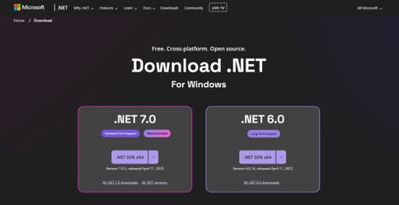
By Installing .NET Core SDK
To download the later version of .NET Core , go to the following website and select the platform you are using.
https://dotnet.microsoft.com/download
Notes:
Alright, folks, let's talk about getting started with .NET Core. If you want to grab the latest version, just head over to dotnet.microsoft.com/download.
Once you're there, you'll see options for different platforms. Just pick the one that matches what you're using.
It's pretty straightforward, just a couple of clicks, and you'll be on your way to installing the .NET Core SDK.
Remember, keeping your tools up to date is key to smooth sailing in your development journey. So, don't hesitate to grab the latest version and get started on your projects!

Slide 12
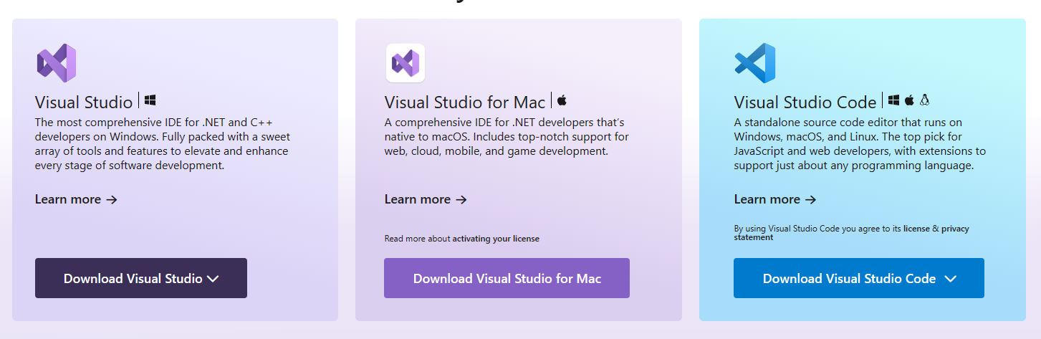
Install Visual Studio
Step 1:
Download and install Visual Studio installer from the link below :
https://visualstudio.microsoft.com/
Notes:
Alright, let's get Visual Studio installed. First things first, head over to visualstudio.microsoft.com.
Once you're there, look for the download section and grab the Visual Studio installer.
This installer is your gateway to all the tools and features that Visual Studio has to offer for your development projects.
So, go ahead, download it, and let's move on to the next step in setting up your development environment.

Slide 13
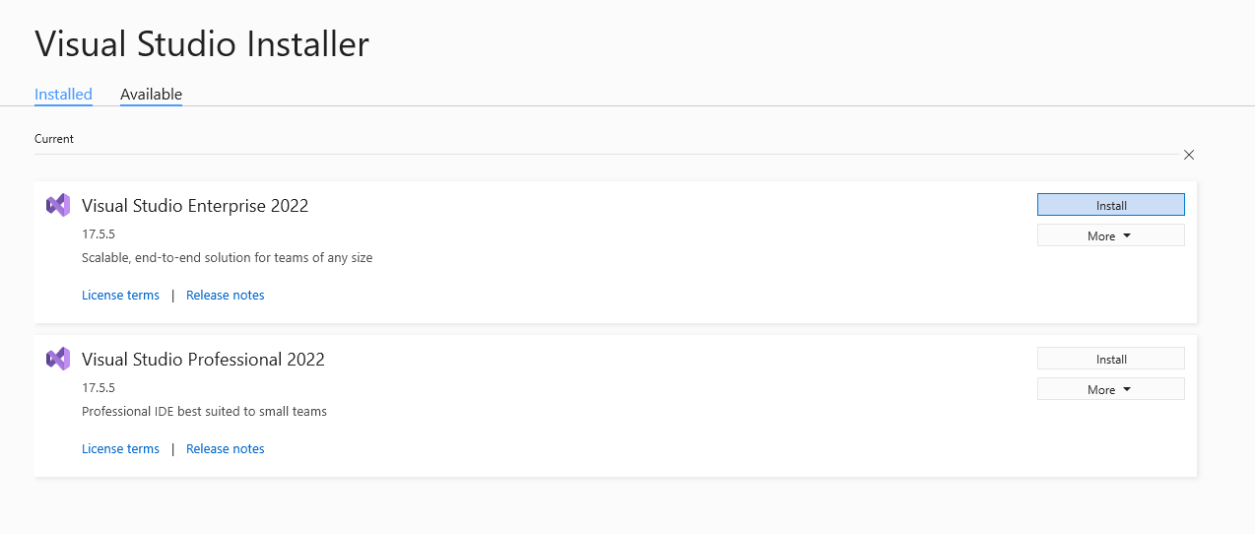
Step 2 :
Run the installer and select appropriate visual studio from the Available tab And click Install
Notes:
Run the installer and select appropriate visual studio from the Available tab And click Install

Slide 14
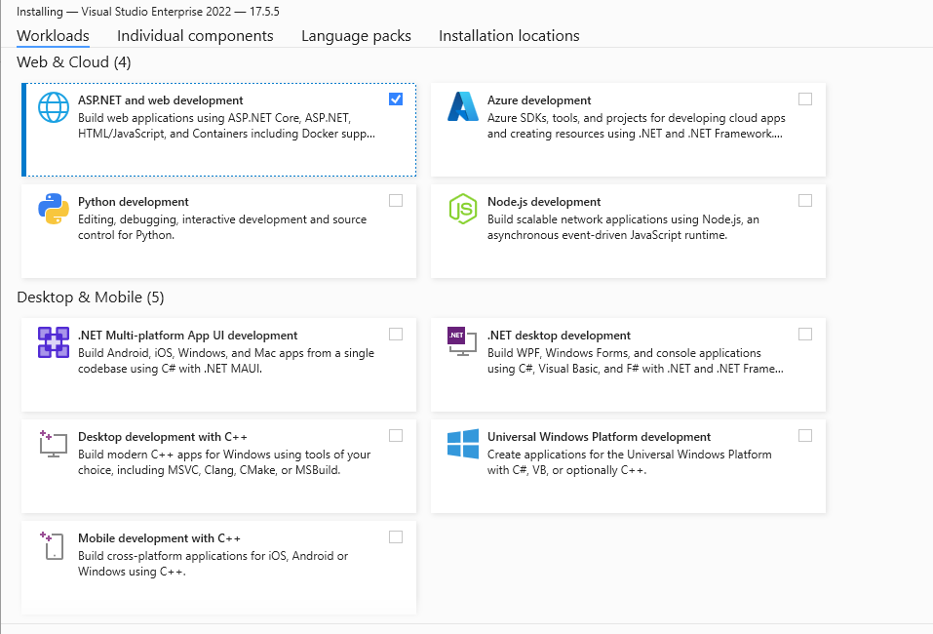
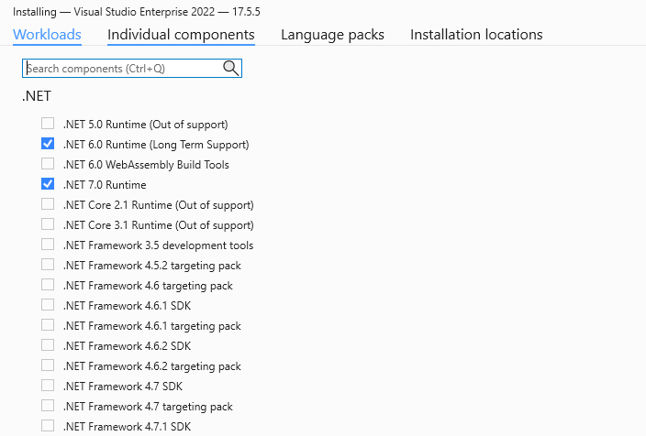
Step 3 :
From the workloads select Asp.net and web development.
From Individual components select .Net Runtime you want.
Click Install
Notes:
From the workloads select Asp.net and web development.
From Individual components select .Net Runtime you want.
Click Install

Slide 15
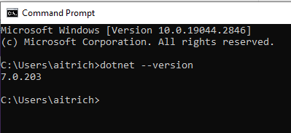
Verify the Installaion
Notes:
Please verify that the installation is correct

Slide 16
Thank You
Notes:
Thank you for your attention throughout this presentation.
In summary, we've explored the diverse range of technologies included in the .NET ecosystem, covering various application types and platforms.
Remember to verify that the installation process has been completed correctly to ensure smooth operation of the software.
If you have any further questions or require additional information, please feel free to reach out.
We look forward to hearing your feedback and assisting you with any future endeavors involving .NET development.
Once again, thank you for your time and participation.

